Slide 1
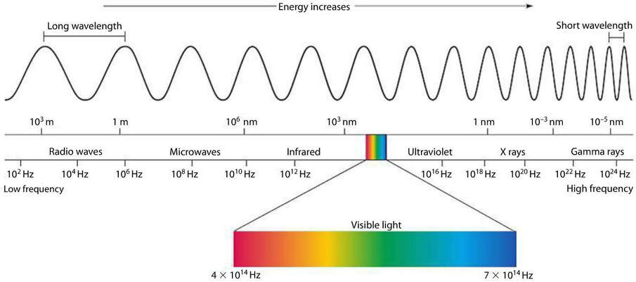
Short λ = ___________ energy
Short λ = ___________ frequency
High f = ___________ energy
λ = v x f
Where:
λ = wavelength
v = velocity/speed of wave
f = frequency of wave
Electromagnetic Spectrum
Draw and label a wave:
        Increasing:
        Increasing:
1s
2s
        Decreasing:
What is it / explanation:
Uses:
Possible harm to living things:
What is it / explanation:
Uses:
Possible harm to living things:
What is it / explanation:
Uses:
Possible harm to living things:
What is it / explanation:
Uses:
Possible harm to living things:
What is it / explanation:
Uses:
Possible harm to living things:
What is it / explanation:
Uses:
Possible harm to living things:
What is it / explanation:
Uses:
Possible harm to living things:

